Slide 1
Brain Matrix

Slide 2
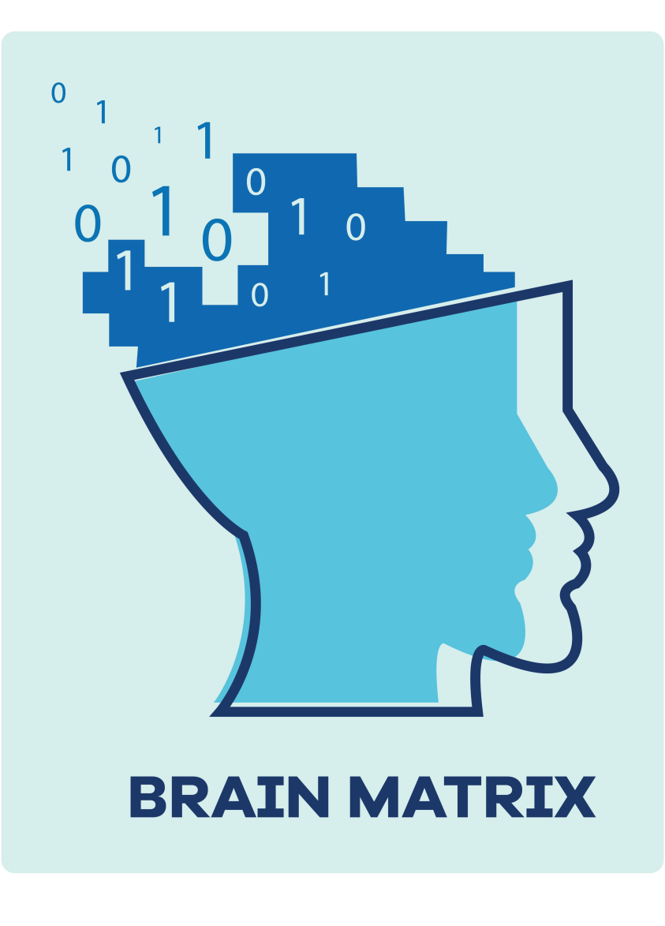
LOGO

Slide 3





Tools and technologies

Slide 4
Software process Model
Agile Unified Process model

Slide 5
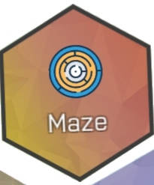
Mini games
1: Maze Escape
Maze is an relaxing activity that can help to improve eye coordination for people with dementia.

Slide 6
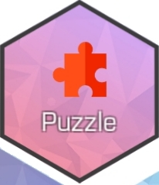
2: Puzzle
Picture puzzles for those living with dementia provide patient with mental stimulation The picture puzzles have been challenging to read small type and perform advanced cognitive problem solving.

Slide 7
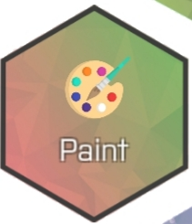
3: Color Draw
Color draw has been used to help treat a wide range of patients suffering from dementia. It has the ability to improve one's quality of life while enhancing the creative mind.

Slide 8
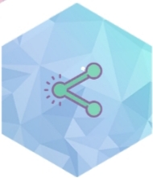
4: Join the Dots
This will provide a great way to test your problem-solving skills. And helps in quickly process information

Slide 9
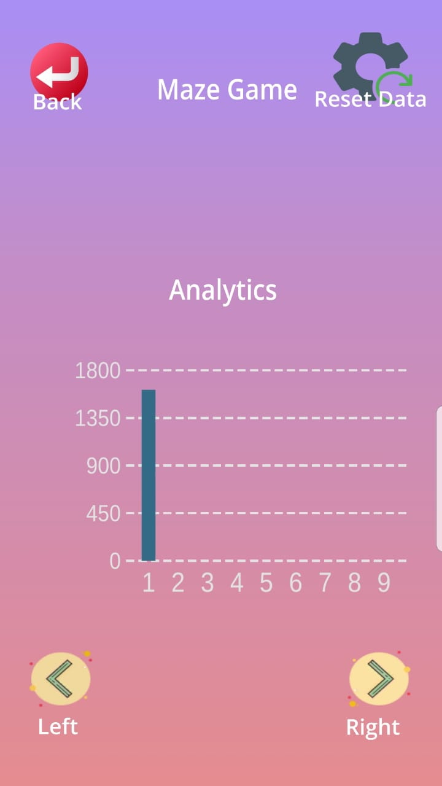
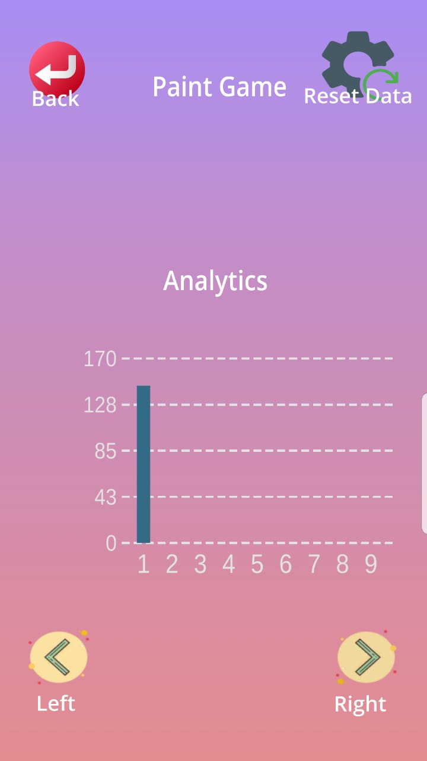
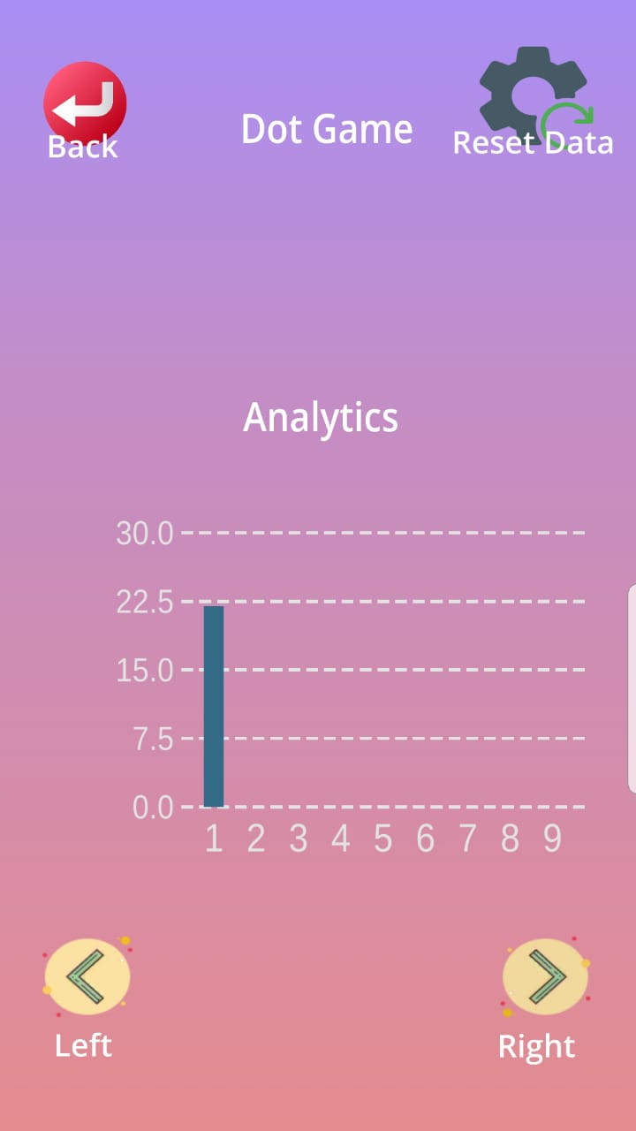
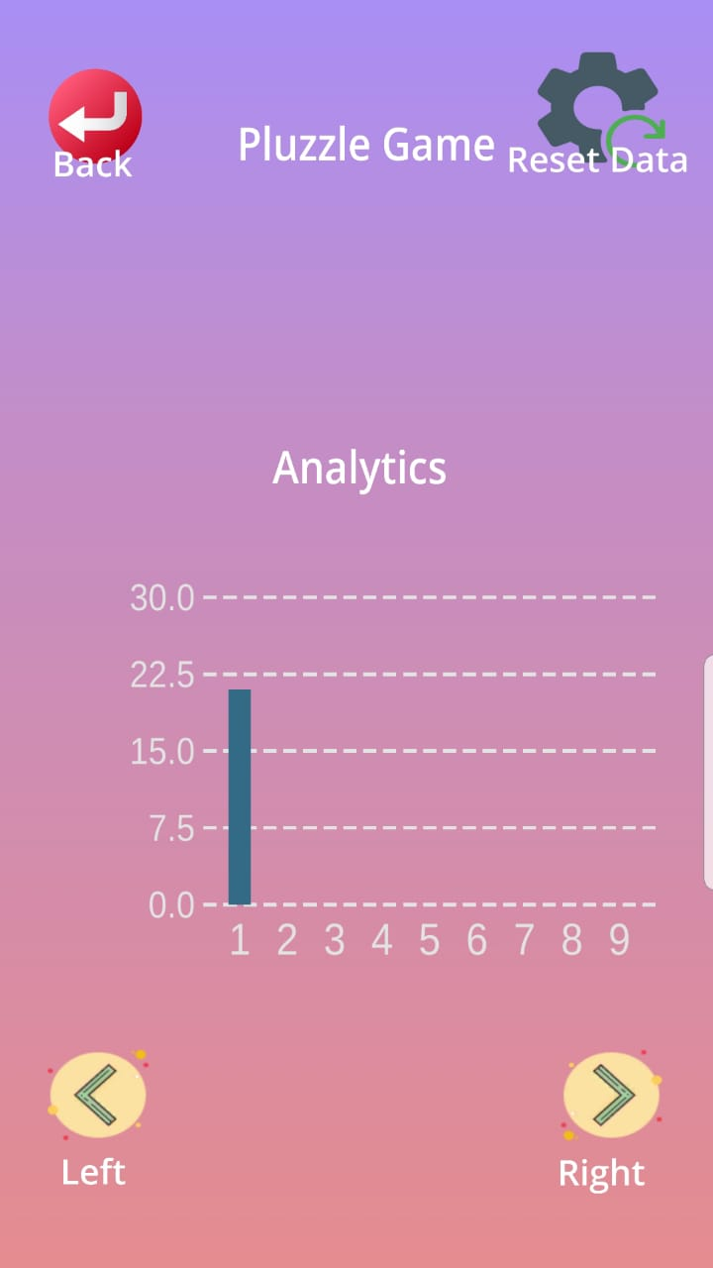
Player Progression Board

